Slide 1
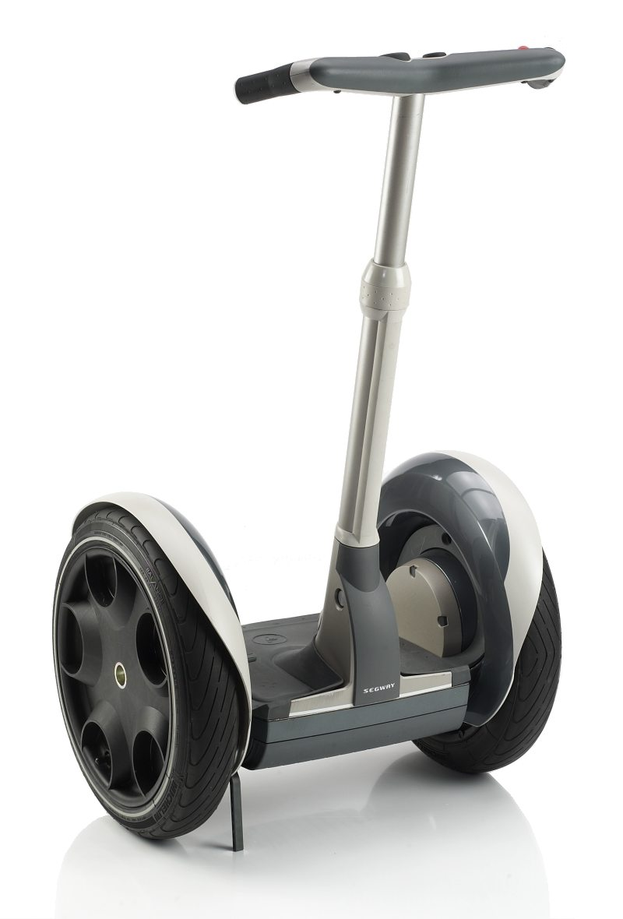
SEMINAR
ON
SEGWAY PERSONAL TRANSPORTER
Presented By: Krunal Faldu
B.Tech (Mech.)
4th Year,8th sem
Guided By: Premaram Chaudhary

Slide 2
What is Segway PT?
Segway is two wheel self balancing transportation vehicle invented by Dean Kamen in 2001 at new york.
It is designed to mirror the process of human walking.

Slide 3
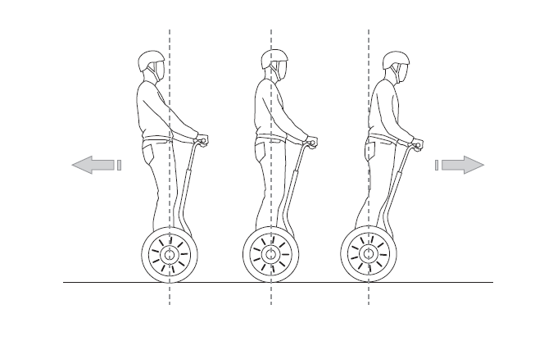
How it work?
User commands the Segway to go forward by shifting their weight forward on the platform ,
And backward by shifting their weight backward.

Slide 4
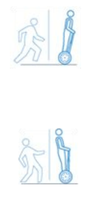
How it self Balance?
Based on the simple principles that govern the movement of the human body.
The Segway has,
wheels legs,
motor muscles,
microprocessors brain and
tilt sensors inner-ear
Like your brain, the Segway knows when you are leaning forward. To maintain balance, it turns the wheels at just the right speed, moving you forward.

Slide 5
Features
Dynamic Stabilization
Electric Propulsion
Smart Battery Management
Digital Dashboard
Advanced Sensing

Slide 6
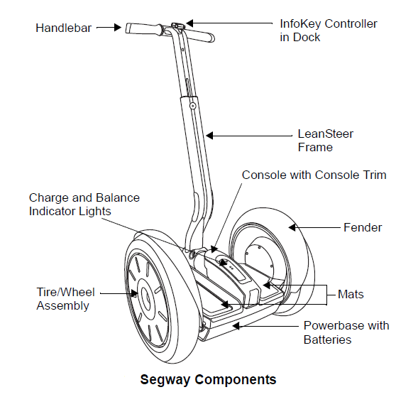
Basic component
Info Key Controller
lean Steer Frame
Handlebar Assembly
Tire/Wheel Assembly
Fenders
Mats
Powerbase
Batteries

Slide 7
Basic Operation
Primary Sensor System
Gyroscope Assembly
Tilt Sensors
Control System
Motor System

Slide 8
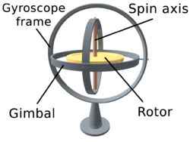
Gyroscope Assembly
A gyroscope is a spinning wheel inside a stable frame which resists changes in its axis of rotation.
Segway's use special solid-state angular rate sensor constructed using silicon. This determines an object's rotation using the Carioles Effect on a very small scale. These are called Solid State Silicon Gyroscopes.

Slide 9
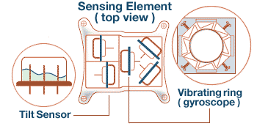
Tilt Sensors
The Segway has two tilt sensors filled with electrolyte fluid.
These tilt sensors can detect the extent of the tilt of the object with respect to the ground.
Like the inner ear in the human body, this system figures out its own position relative to the ground based on the tilt of the fluid surface.

Slide 10
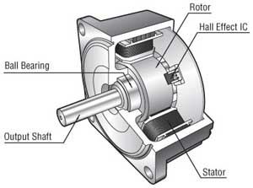
Motor System
The Segway PT features Brushless servo motors with neodymium magnets.
The electric motors are powered by a pair of NiMH or Li-ion batteries.
They make the Segway turn by varying the relative speed of the wheels based on the tilt information sent from the control system.

Slide 11
Motor functioning and Locomotion
Each motor is constructed with two independent sets of windings, each driven by a separate board and motor. Under normal conditions, both sets of windings work in parallel, sharing the load. In the event of a failure, the motor is designed to instantly disable the faulty side and use the remaining winding to maintain control of the Segway HT until it can be brought to a stop.

Slide 12
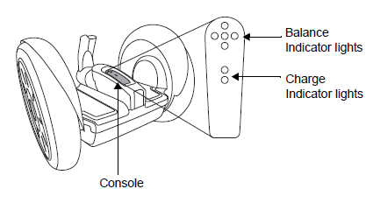
Basic Operation
When the Segway Handle Bar is tilted, the integrated Silicon Gyroscopes detect the degree of rotation as well as the rate of rotation.
This is based on the variation in the vibration of the Silicon particles with respect to the Support Frame of the Gyroscope.

Slide 13
Types of Segway's pt
Segway i2
Segway commuter
Segway i2 cargo
Segway x2
Segway x2 golf
Segway x2 adventure

Slide 14
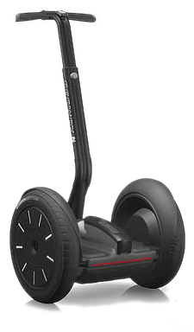
Segway i2
The Segway i2 is the base model Segway. Sleek and light, the i2 will keep you on the move and avoiding the congestion of traffic and the high prices of gas.
The i2 includes a Wireless Info Key Controller, Siphon Lithium-ion batteries, Lean Steer frame height adjust.

Slide 15
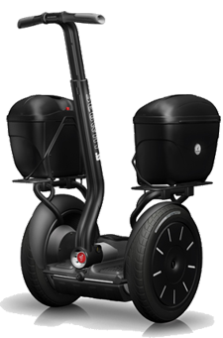
Segway i2 cargo
The i2 Cargo is based on the rugged and sleek design of the i2, but also includes high impact cargo frames and cases to ensure your gear stays safe and dry.
The i2 Cargo includes all of the features of the i2 plus: Segway hard cases that are waterproof and lockable.
Parking stand pivots down to offer support for quick and easy retrieval of items .

Slide 16
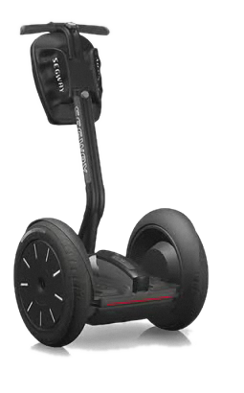
Segway i2 commuter
The Segway i2 Commuter is a step up from the base model Segway. Sleek and light, the i2 commuter will keep you flying past the gas stations.
The i2 Commuter is an eco-friendly, convenient, easy-to-learn alternative to short-distance driving.

Slide 17
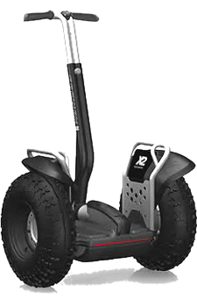
Segway x2
The Segway X2 is designed for those that like to take the road less travelled. It's rugged and tough design will let you create your own path. Whether you are looking to travel or grass, gravel or dirt, the X2 can take you there. The X2 has plenty of ground clearance, stable and smooth ride and the durability that Segway's are famous for.

Slide 18
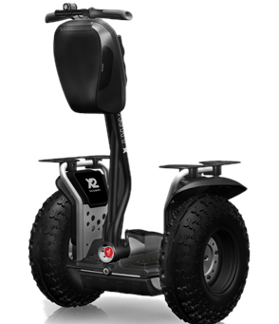
Segway x2 adventure
The Segway X2 Adventures takes you off road and allows you to experience the thrills of nature. Both casual and experienced riders will love the feel and handling of the X2 Adventurer.
The specially equipped handlebar bag is great for storing tools & other equipment.
The X2 Adventures also includes a 5W headlamp and universal cargo plates.

Slide 19
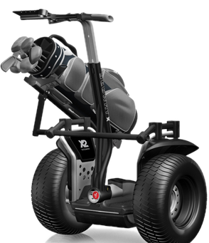
Segway x2 golf
The x2 Golf is the effortless maneuverability on the golf course.
Turf-friendly tires let you travel on the grass and off the cart path for a faster game, and increased height offers the best perspective on the greens. And with an easy-access bag carrier and scorecard holder included in the package, convenience is part for the course.

Slide 20
Applications
Security Applications
Commuting Applications
Corporate Applications

Slide 21
Environmental Benefits
The Segway PT has many benefits for you and the environment.
It also reduces the impact of global warming by checking greenhouse gas output and fossil fuel consumption.
If we are able to replace 10% of 900 million car travel to 3 mile with the Segway PT there would be:
6.2 million fewer gallons of gas consumed.
286 million fewer pounds of CO₂ emitted every day.

